Slide 1
Manuel Bensi ⁽¹⁾, Dimitris Velaoras ⁽²⁾, Virna Meccia ⁽³⁾, Vanessa Cardin*⁽¹⁾, ⁽¹⁾ National Institute of Oceanography and Experimental Oceanography (OGS), Italy (*vcardin@inogs.it). ⁽²⁾ Hellenic Centre for Marine Research Institute of Oceanography (HCMR), Greece. ⁽³⁾ Institute of Marine Sciences - National Research Council, ISMAR-CNR, Trieste.
Effects of the Eastern Mediterranean Sea circulation on the thermohaline properties as recorded by fixed deep-ocean observatories
Notes:
Effects of the Eastern Mediterranean Sea circulation on the thermohaline properties as recorded by fixed deep-ocean observatories

Slide 2
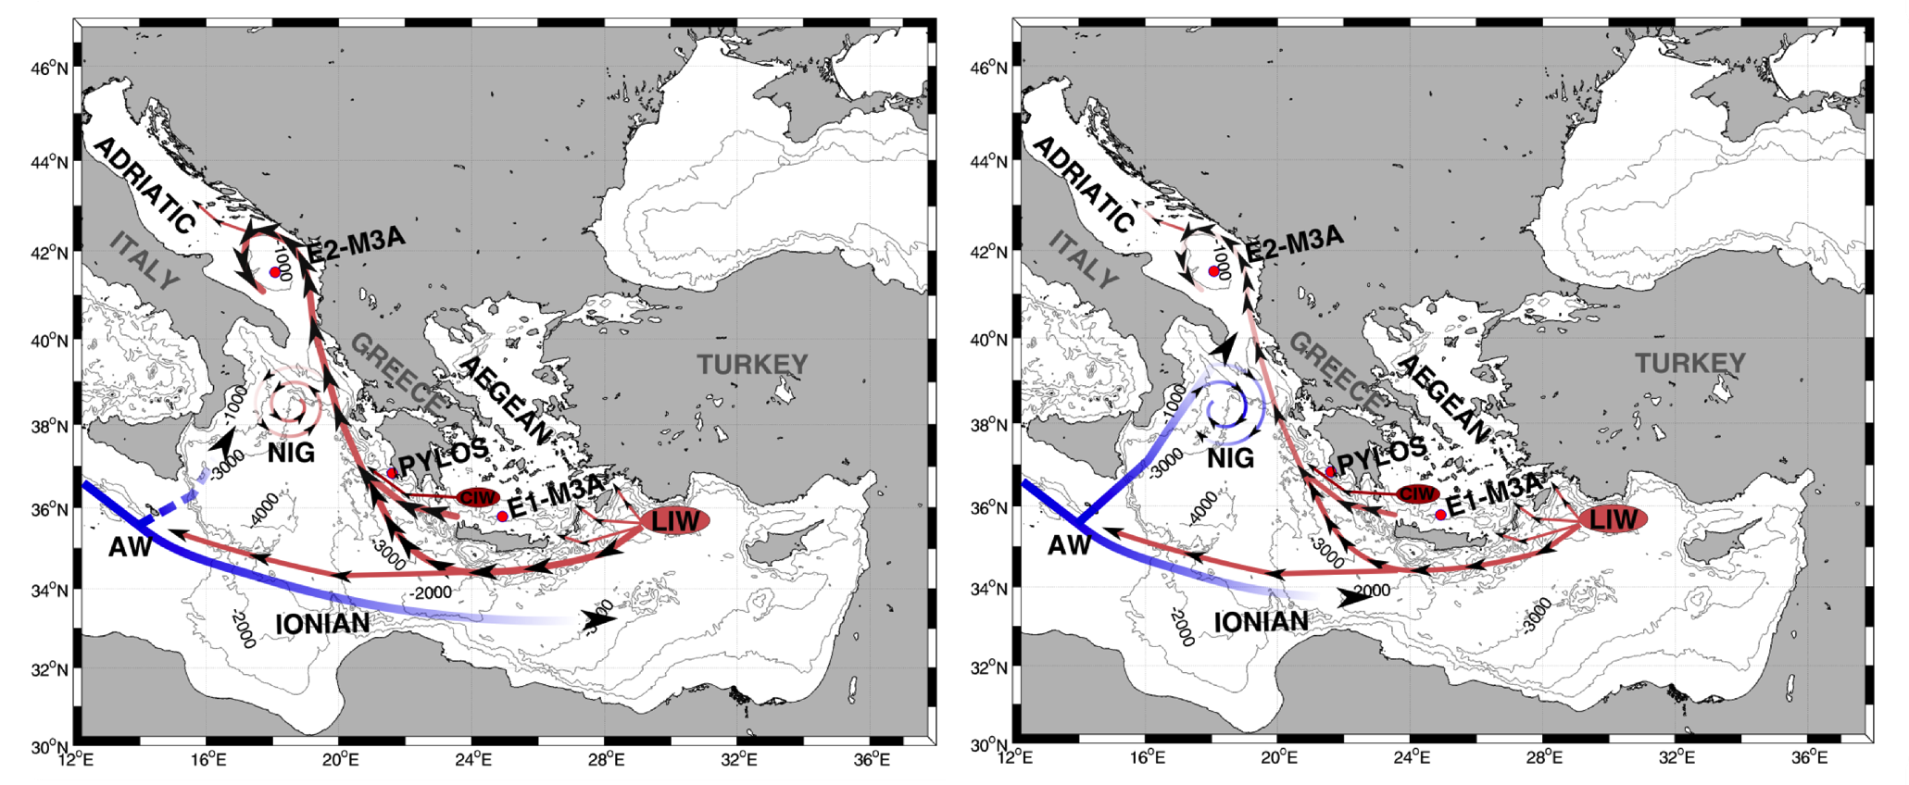
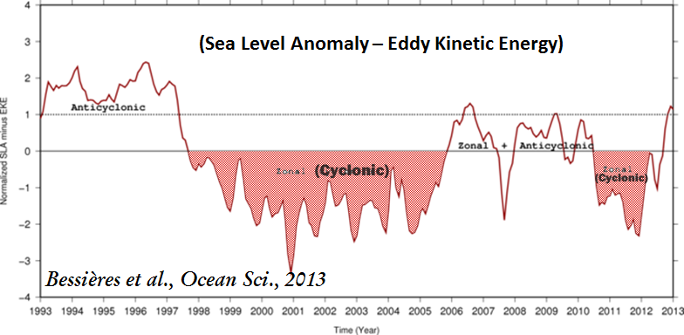
Introduction: The general circulation of the Eastern Mediterranean
NIG = North Ionian Gyre; LIW = Levantine Intermediate Water; CIW = Cretan intermediate water; AW = Atlantic water
Cyclonic
Anti-Cyclonic

Slide 3
Objective: Contribute to the understanding of the long-term thermohaline variability of the EMed and to highlight the importance an the potential of data retrieved through open-sea observatories
METHODS
Analyse time series data: temperature, salinity, density
Data are harmonized (3 hrs sample time), quality checked, interpolated, and filtered (low pass 33h)
Statistical analyses (correlation, cross-correlation, time-delay calculation)
Long-term variability (e.g. trends)
Wavelet transform applied to time-series
Integrate spatially fixed-point observations: float and glider data

Slide 4
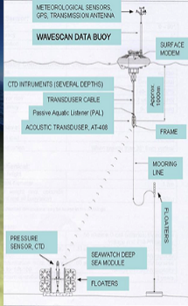
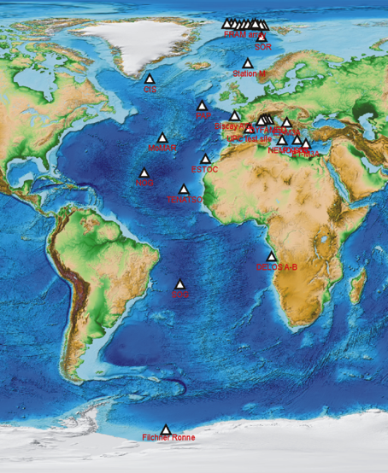
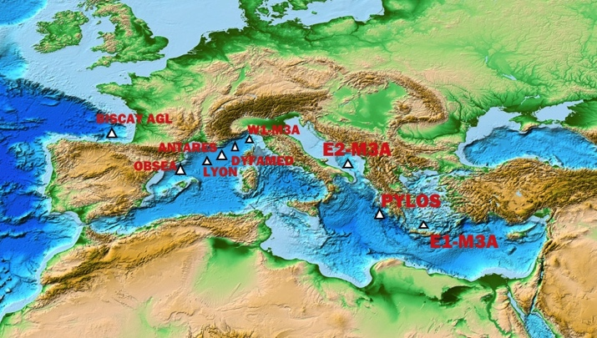
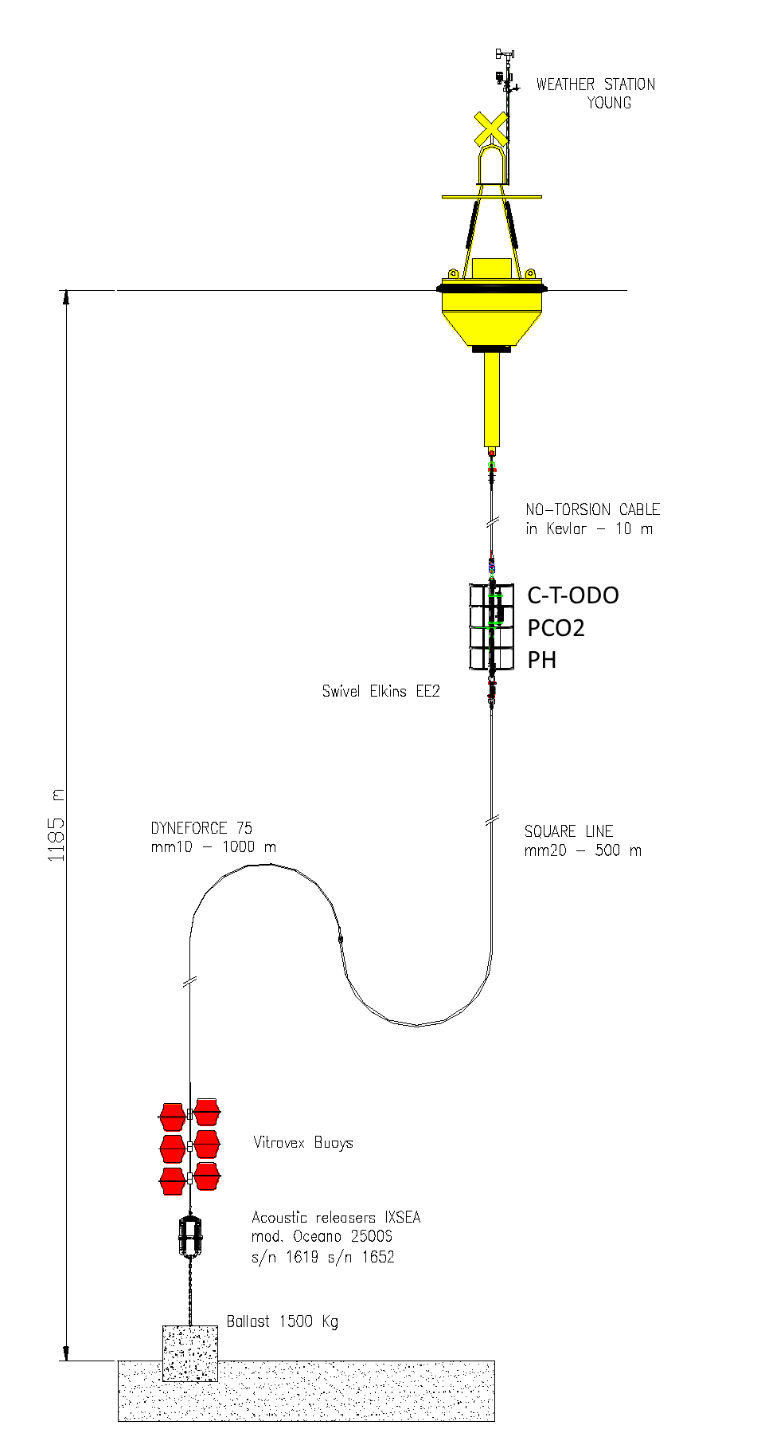
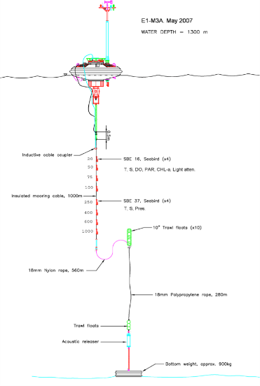
Eastern Mediterranean Open Ocean Observatories
PYLOS
E2-M3A
E1-M3A
www.fixo3.eu

Slide 5
Relations between the three observatories:
Impacts of a cyclonic or anti-cyclonic phases of the North Ionian Gyre (NIG)
SALINITY
Adriatic – E1M3A
Ionian - PYLOS
Cretan – E1M3A
*Colored rotors indicate the NIG phases

Slide 6
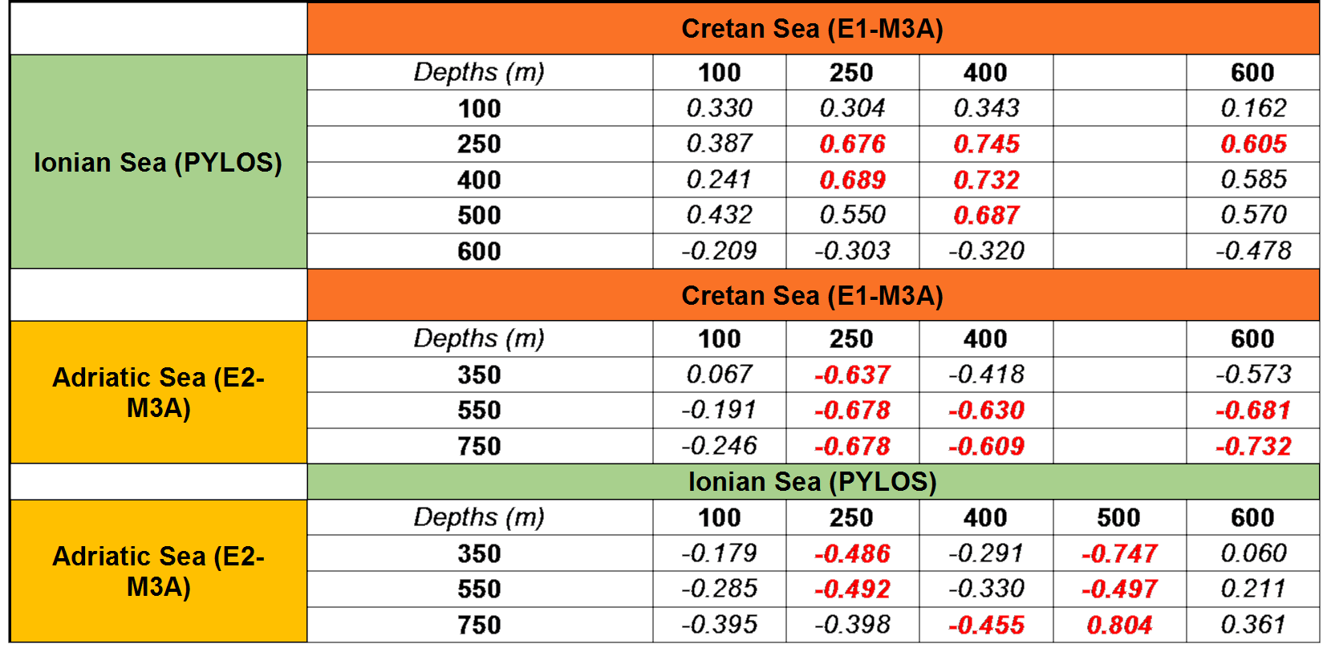
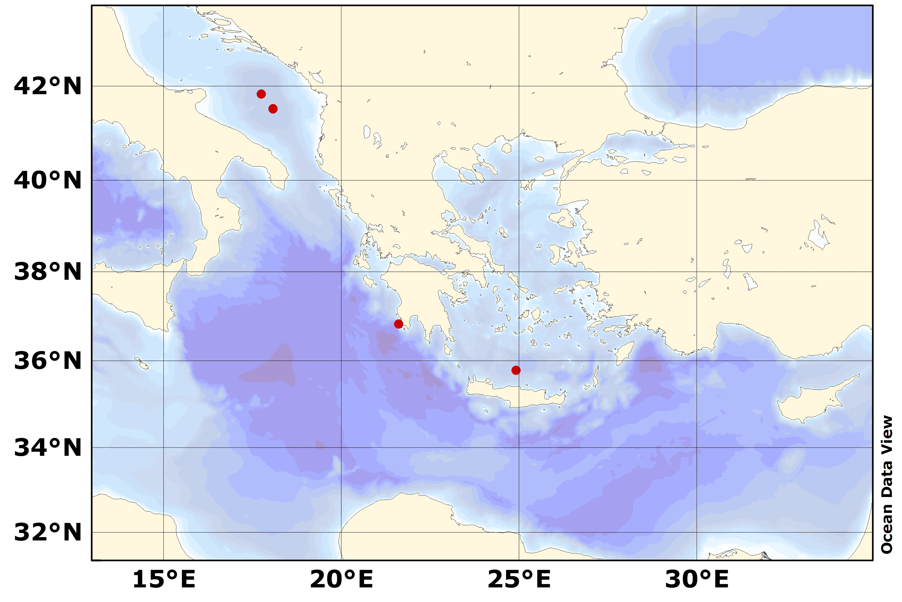
Results: Relation among the three sites – Salinity Correlation
Ionian (Pylos)
Salinity
Adriatic (E2-M3A)
~ 12
~ 4
Cretan (E1-M3A)

Slide 7
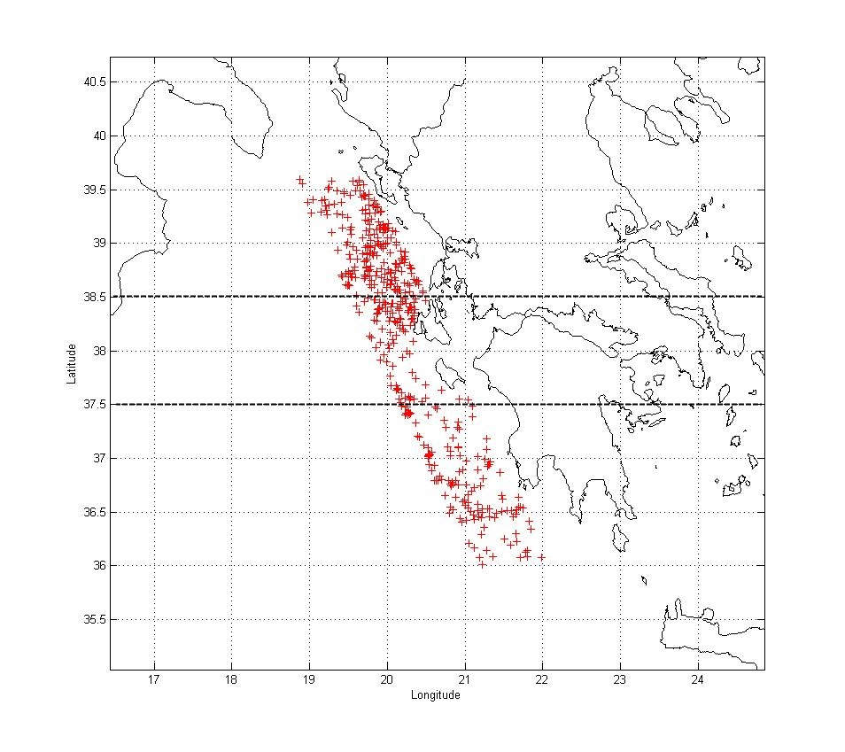
Results: 10 years of yearly averaged salinity data in the easternmost part of the Ionian Sea
Pylos 250m
E2-M3A
Pylos 400m
PYLOS
Cretan
E1-M3A
Ionian
Adriatic

Slide 8
Results: High frequency variability: identifying mesoscale events
E2M3A - ADRIATIC SEA
Average wavelet power spectra corresponding to periods between 13-17 days
Associated to deep water formation in the Adriatic?
Associated to advection?

Slide 9
Synoptic fields of θ(450m) and S(750m) from daily mean reanalysis of the MFS close to E3-M3A

Slide 10
Results: CRETAN SEA
Summer event present from 250 to 600 m and in both variables
In general Temperature and Salinity have similar beahaviour

Slide 12
Conclusions
Data from fixed observatories represent very well the thermohaline variability of their own region.
Statistical correlations among the three stations reveal:
Positive correlation between Ionian and Cretan sites
Negative correlation between Adriatic and Cretan
The estimation of travel time of the salinity signal from the Cretan Sea to the Adriatic indicates that the LIW/CIW water masses take approximately 4-5 months to reach PYLOS and 10 -14 months to reach the Adriatic from the Cretan Sea
Wavelet transform highlighted typical periodicities that deserve particular attention:
15d, 30d. We focused our attention on periodicities of about 15 days
Our results show that the wavelet allows us to associate typical mesoscale periodicities to dense water formation events (Adriatic) and advection or eddies passages (Adriatic and Cretan)

Slide 13
Thanks for your attention

